Slide 1
FFT 2018/19 Fundraising Report & Plan
June 16, 2018
“The definition of insanity is doing the same thing over and over and expecting different results”
Notes:
Thank Bob and John for working on the Expense side of the Budget – now for the Revenue side. Let’ take an in depth look at our sources of revenue, past performance and determine future goals

Slide 2
Revenue Sources
Individual
Corporate
Board
Grants
Events

Slide 3
Events
Rock-A-Belly
Colorado Gives Day
Del Frisco Golf Experience
Colfax Marathon
Elephant Rock Ride
Others
Notes:
These are out key events in order of revenue generation. Now let’s break it down

Slide 4
Rock-A-Belly
 | Total Expenses | Sponsorship Revenue | Ticket Sale/Donation Revenue | RAB Net Proceeds
2014 | 44,172 | 95,350 | 28,026 | 79,204
2015 | 15,267 | 64,950 | 17,111 | 66,794
2016 | 9,788 | 81,000 | 34,864 | 95,577
2017 | 11,845 | 54,850 | 48,394 | 91,399
2018/19 Goal |  |  |  | 100,000

Slide 5
Colorado Gives Day
 | % Increase | Incentive Fund share | Processing fees | # of CG Donors | % Increase | Returning Donors | New CG Donors | Average Donation | CG Total Donations
2016 | n/a | $801.15 | $401.96 | 69 | n/a | 0 | 69 | $363.88 | $25,108.00
2017 | 238% | $3,632.76 | $1,557.01 | 136 | 97% | 23 | 113 | $1,230.81 | $84,926.00
2017 (Adjusted) | 79% |  |  |  |  |  |  | 330.34 | $44,926.00
2018 Goal | 50% |  |  | 244 | 80% |  |  | $276.18 | $67,389.00

Slide 6
Del Frisco Golf Experience
Year | Total Revenue
2015 | 35,150
2016 | 50,651
2017 | 41,412
2018/19 Goal | 50,000

Slide 7
Colfax Marathon
 | Runners | Teams | Companies | Winning Teams | Prize Winnings | Runner CF | # of Donors | Average Donation | CF Proceeds | Total Revenue
2017 | 52 | 8 | 5 | 4 | 5,000 | 1 | 10 | 57.50 | 575 | 5,575
2018 | 54 | 9 | 3 | 1 | 1,000 | 2 | 54 | 64.81 | 3,500 | 4,500
Total |  |  |  |  |  |  |  |  |  | 10,075
2018 Goal | 60 | 10 | 4 | 1 | 1,000 | 5 | 70 | 60.00 | 4,200 | 5,200
Notes:
Expenses water, burritos, shirts

Slide 8
Elephant Rock Ride/Bike for Backpacks
The CE Shop Foundation mission has a shared mission of feeding kids through their Bike for Backpack program.
In 2017, committed to sponsor Marie L. Greenwood Elementary
Committed $40,000 in 2017/18 through proceeds of a 5 day Rockies ride
Committed $20,000 in 2018/19 Elephant Rock Ride - $20,000

Slide 9
Other Fundraisers
Whole Foods - Donate at the Register
Medix Cornhole Tournament
Lamar Street Food Truck Roundup
Spendifference Casino Night
Patagonia Store Soup Sales
Bubba’s 33 Restaurant Opening
Janus Food Drive
Top Golf Professionals Networking event
Visa pre-paid card promotion at Customer Conference
One Hope Wine
Italian Car Show
Lucille’s T-shirt contest
QEP Resources Casual for a Cause
Mile High 100
Penny Harvest
Morgan Stanley Denim Day BBQ
Corenet Bocce Ball Tournament
Janus Virtual Food Drive
Carson Elementary Virtual Food Drive
Notes:
These range from 20K Whole Foods to $180….

Slide 10
Individual Donors
Recurring Donors info
Total number of donors by year
Average donation amount
Notes:
Lots of crossover here with our events – ie the crowdfunding part of CM and Elephant Rock,

Slide 11
Corporate Donors
Emphasis on donations for Corporate Teams who volunteer
Adopt-A-School
Internal company events to benefit FFT
Continue to develop materials, messaging etc. to enable our supporters to share our message
Develop/refine packaged options for participation
Notes:
Lots of crossover here with events.

Slide 12
Grants
Grant History
Grant Forecast
Grant Strategy

Slide 13
Grant Strategy
Hired JVA Consulting to create a Colorado Common Grant Template and to research grant prospects. Delivered in May.
Identified 4 grants to assign to JVA for submission
Organized grant committee – created process, calendar,
Ben Waymire
Nirav Shah
Mellanie Barnier
Jeane Larkins

Slide 14
Grant Strategy (cont)
Next Steps
Continue process with JVA on 4 grants
Assign other grant prospects to committee members
Utilize grant tracking available in Salesforce
Maintain accurate grant calendar to track prospects, progress and wins/losses
Create a plan for future in-house grant research
Meet grant goals for 2018/19

Slide 15
Board Giving
Important!!!!
Our promise to underwrite operating expenses
Grant funders expect 100% as a sign of a healthy board and organization
Goal - $35,000 – Does this cover our administrative expenses?

Slide 16
2018/19 Commitments & Prospects
3 figure grant verbal commitment from Key
Strong commitments from The CE Shop, PrimeSource Staffing
VISA is working on this year’s gift – locally committed, changes to philanthropy program at the headquarter level
Steady commitment from corporate sponsors ie Galloway, Waner, Adolfson Peterson, Fresca Foods,
CoBiz Bash or large donation
Notes:
Guessing 5 year grant at 20,000 year – Key
School Sponsors – The CE Shop $20K, Prime Source Staffing, $20K - Prospects – IMA,

Slide 17
Sources of Revenue 2018/19 Goals
Individual - $325,000
Corporate - $225,000
Board - $35,000
Grants $60,000
Corporate - $10,000
Foundation - $40,000
NonProfit- $10,000
Events - $150,000
Other
Is there a gap?
Notes:
795

Slide 18
Planning to hit our goals
Strategy/Financial Plan for each event
Continue to Build through Salesforce
Track donor activity
Continue to engage volunteers to help us raise funds
Communication Plan
Social Media Calendar
Website
Email
Messaging at volunteer events
Printed promotional materials

Slide 19
Other potential fundraising opportunities
Helping Habit – donation portal on volunteer pages
Spare Change app
Donate your vehicle program
Others?

Slide 20
Other Goals
Evaluate & Refine Recognition Strategies
Utilize the power of data(SF) to target asks
Ensure the communications plan is reflective of our fundraising goals

Slide 21
Colfax Marathon
Pros
Cons
Revenue
Exposure/Free Publicity
Our donor expect us to be there
Donor contact at a fun event
Expense – tshirts, burritos, water
Time & Resources
Tough to get runners to fundraise
Notes:
Bob donated shirts last year

Slide 22
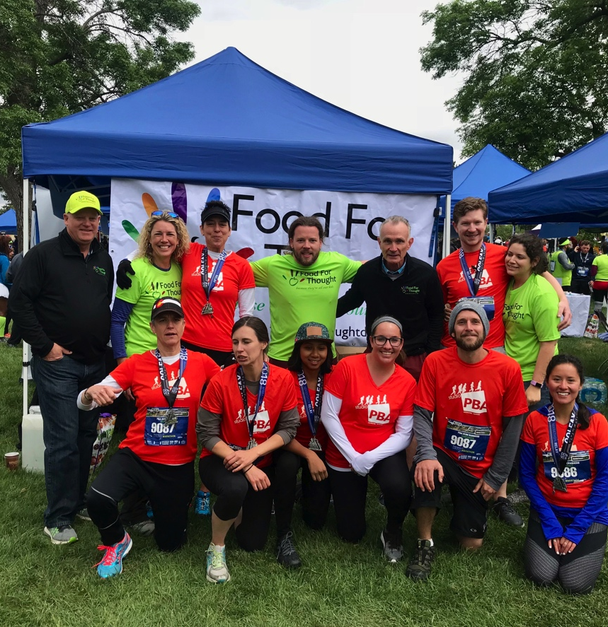
Colfax Marathon Strategies
Find Volunteer to Coordinate
More/Targeted Social Media coverage
Personalized outreach to previous runners
Targeted message to corporate volunteer groups

