Slide 1
Place Postage Here
The Problem
Kids in Denver are Hungry! More than 26,000 students within Denver Public Schools live in low-income families. These families rely on federally funded school breakfast and lunch programs as their main nutritional meals. On the weekends, food is scarce and many of these students go without.
Our Approach
Food For Thought is a 501 (c) (3) non-profit organization dedicated to providing food to needy kids. Food for Thought – Denver uses collected donations and buys food which is then packaged into “PowerSacks” that are delivered to schools in need and distributed to classrooms full of kids.
Our Impact
Each PowerSack delivered is filled with nutritious, non-perishable goods in a quantity that will feed a family of four, two meals, over the weekend. These PowerSacks go a long way to keeping Denver children fed, and sets the stage for them to learn when back in the classroom on Monday!

Slide 2
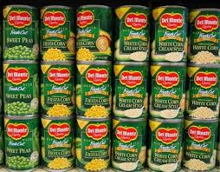
Donate
www.foodforthoughtdenver.org
$4 is the cost of one PowerSack
$128 is the cost to fill a child’s PowerSack for the 32 weeks of the school year
Volunteer
www.foodforthoughtdenver.org
Sign Up Today, as an individual or a group!
We welcome anyone who wants to get their community, their company, or their school involved in a great cause.

